Slide 1
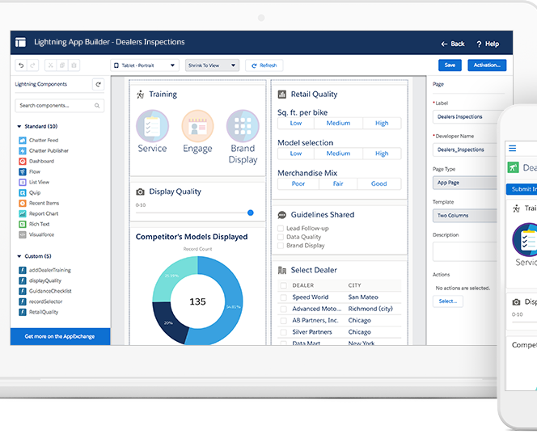

Certification Management App
PREPARED FOR:
CRM SFDC Training Program
Capgemini Technology Services
PREPARED BY:
Sanchal Shanu
46022661
MENTOR:
Rahul Vikas
Salesforce Admin and Developer
Notes:
NOTE:
To change the image on this slide, select the picture and delete it. Then click the Pictures icon in the placeholder to insert your own image.

Slide 2
Abstract:
The Certification Management App is a Salesforce application for managing certification process.
The Certification Management Application is a Salesforce-based certification manager.
The basis of the project is to help keep track of the Employees' who have completed their certification. Also, here the app allows only 2 types of profile in this whole system, which includes the "App User" and the "App Admin".
The App admin is the one who produces the Certifications and the Vouchers for them.
The role of the App User is to add Employees and create Certification Request for these employees, which is further reviewed by the App Admin.
The application also gives us information about the results of the Certification Exam for each Employee. Apart from this, the app includes Reports and Dashboards which helps us in compiling information more easily.
The application likewise use the power of Lightning Web Components for building the UI for the application.

Slide 3

Custom Objects and Type Of Users:
Custom Objects:
Employee: This object is used to add data about employee.
Certification: This object is used to add certification details.
Voucher: This object is used to add voucher details.
Certification Request: This object is used to add certification request of an employee who applies for a certification.
Type Of Users:
App User : is the person who add Employees and make Certification Request for employees.
App Admin: is the person who add Certifications and Vouchers .

Slide 4
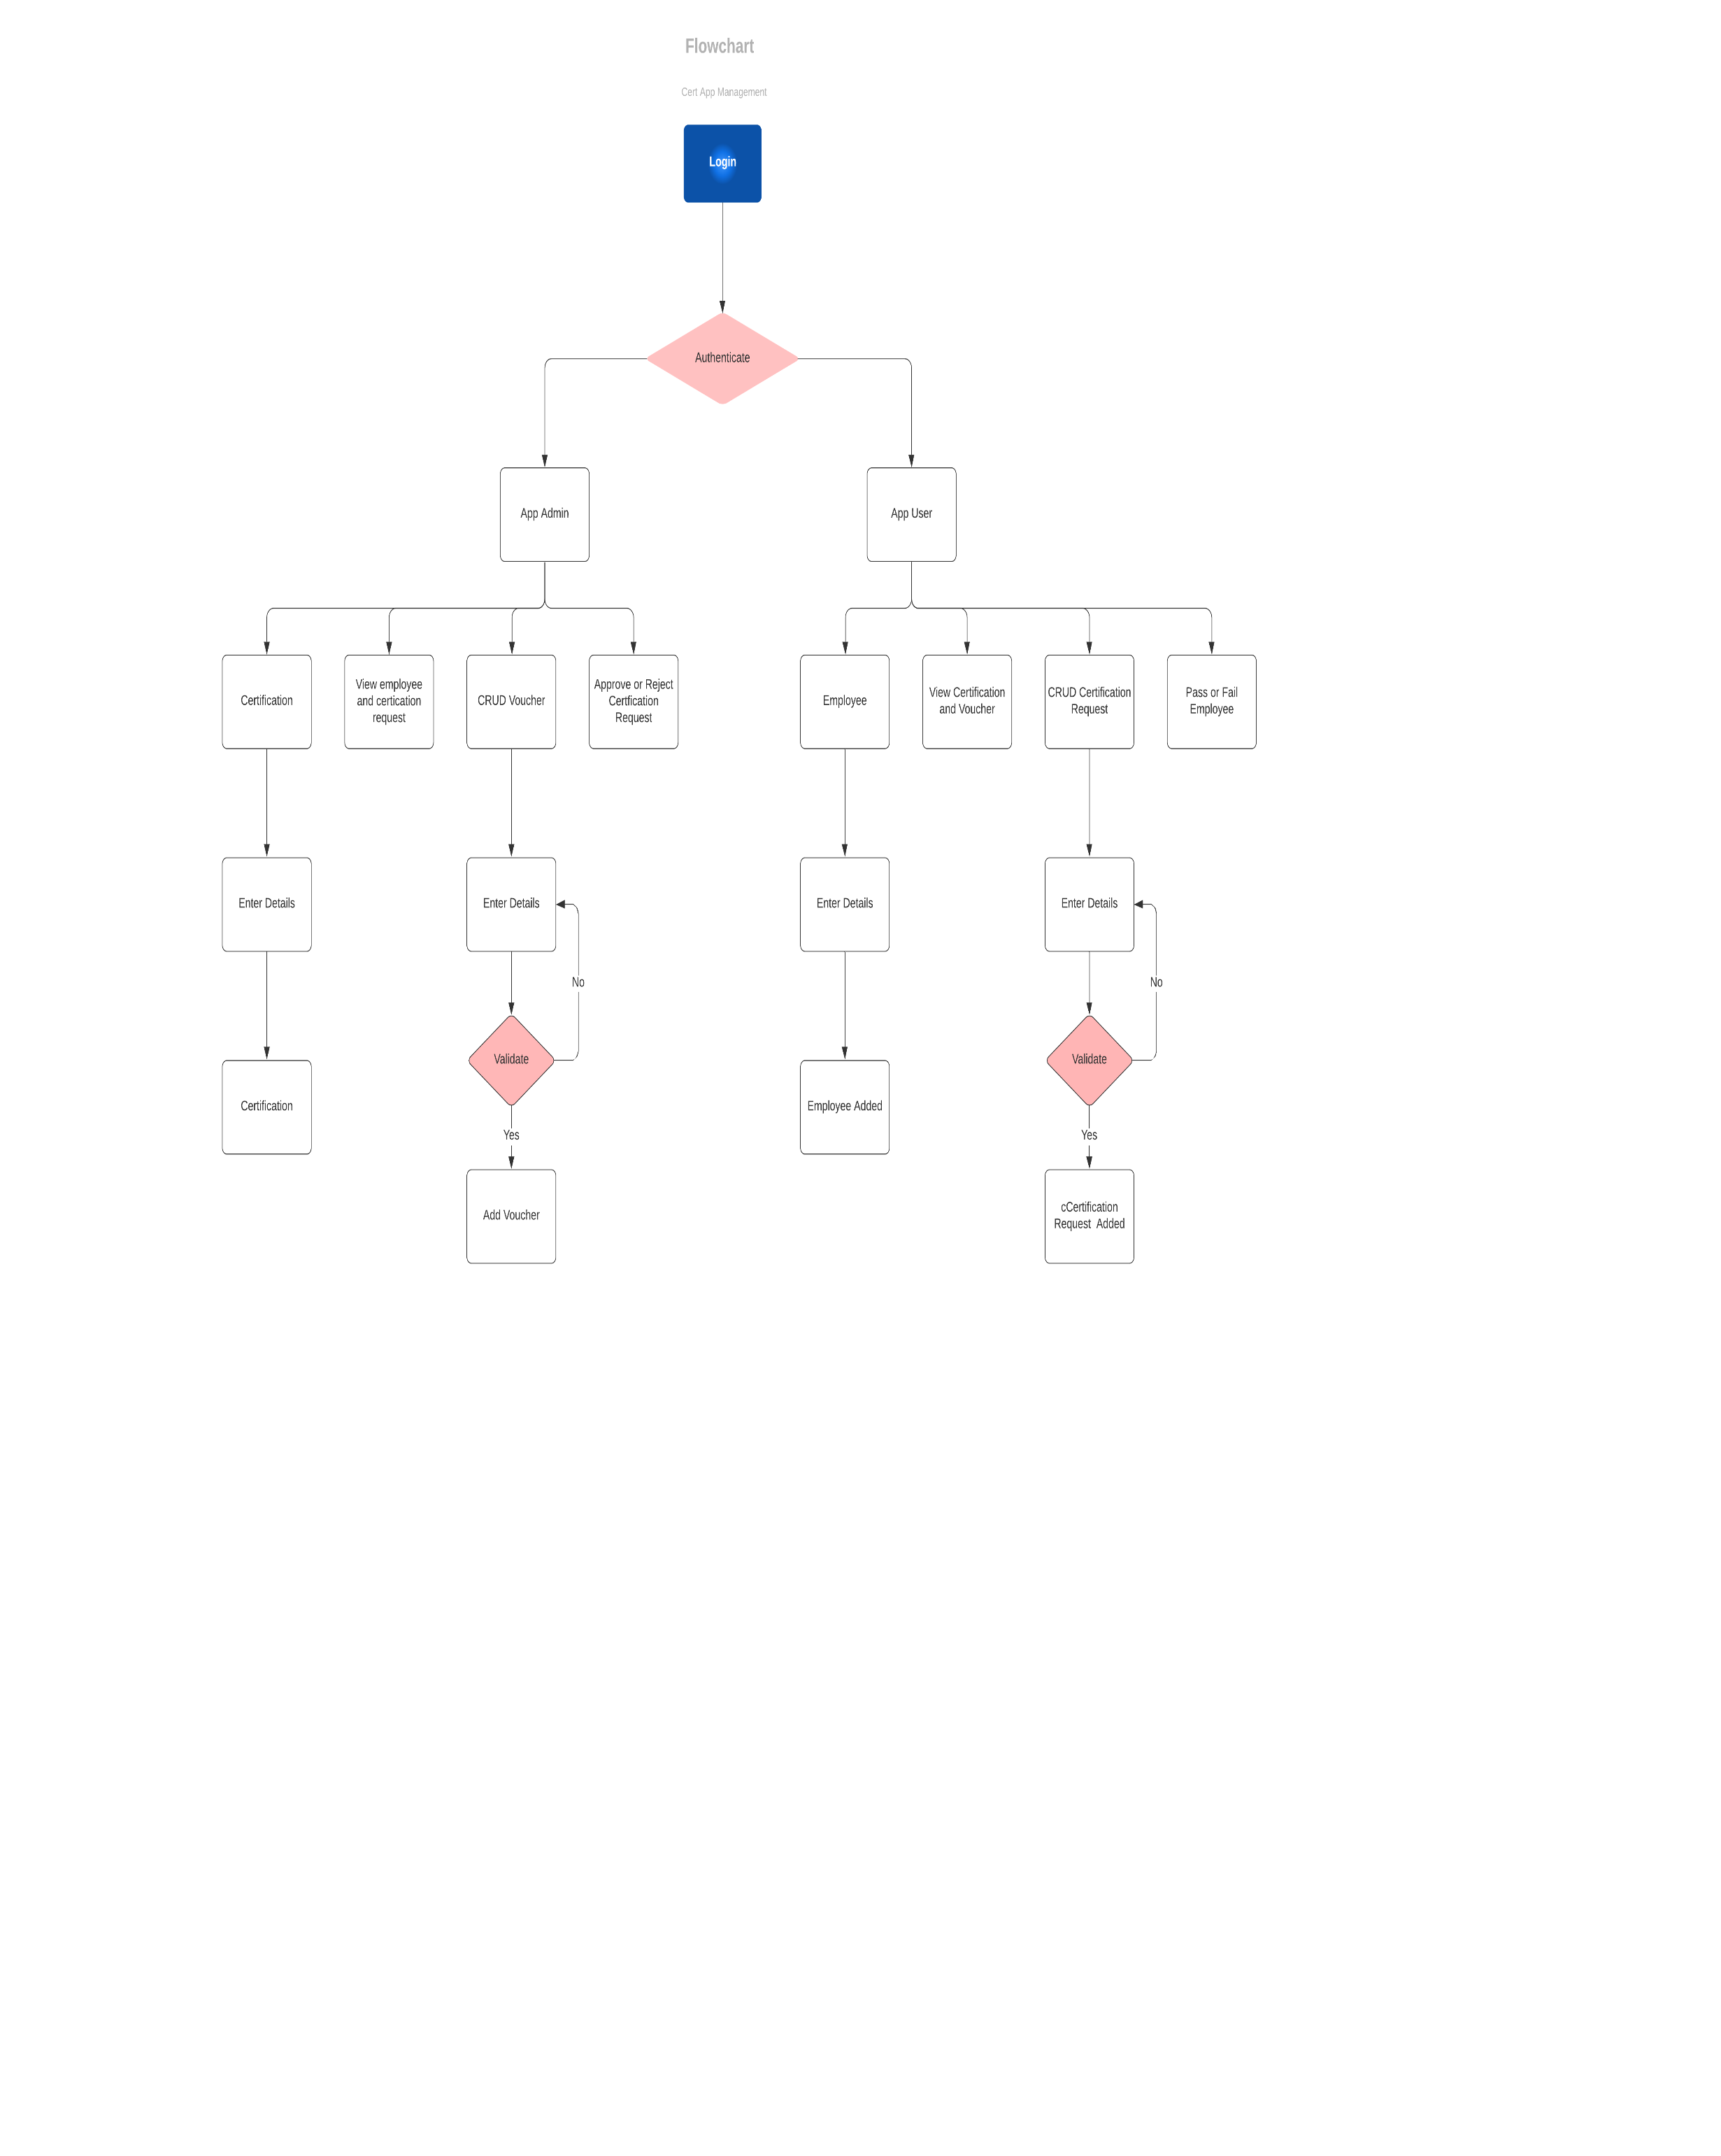

Slide 5
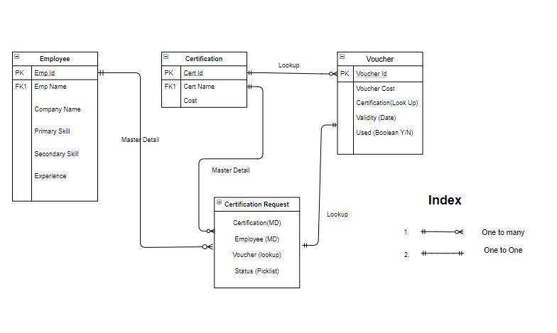
Relationship between objects:

Slide 6
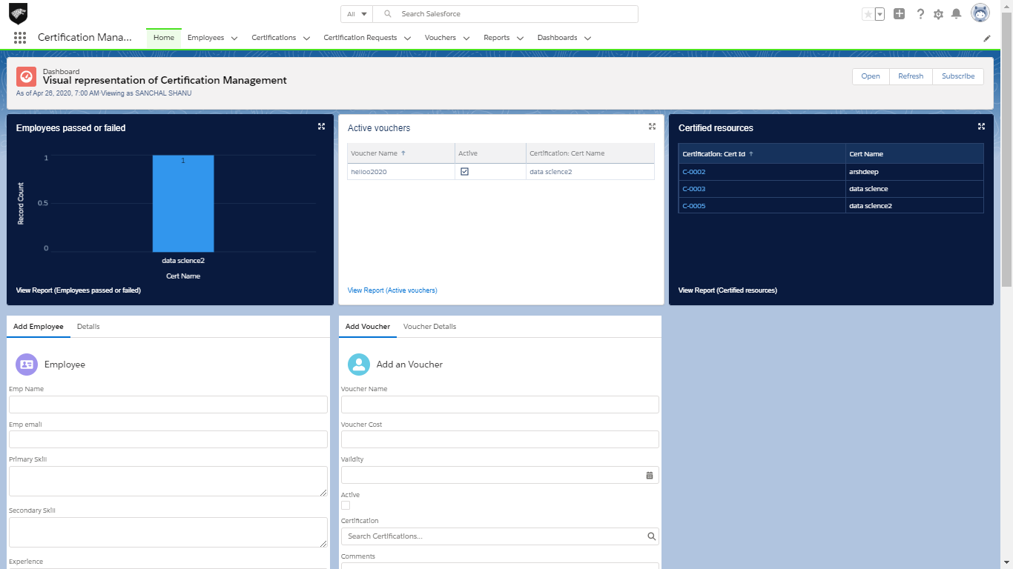
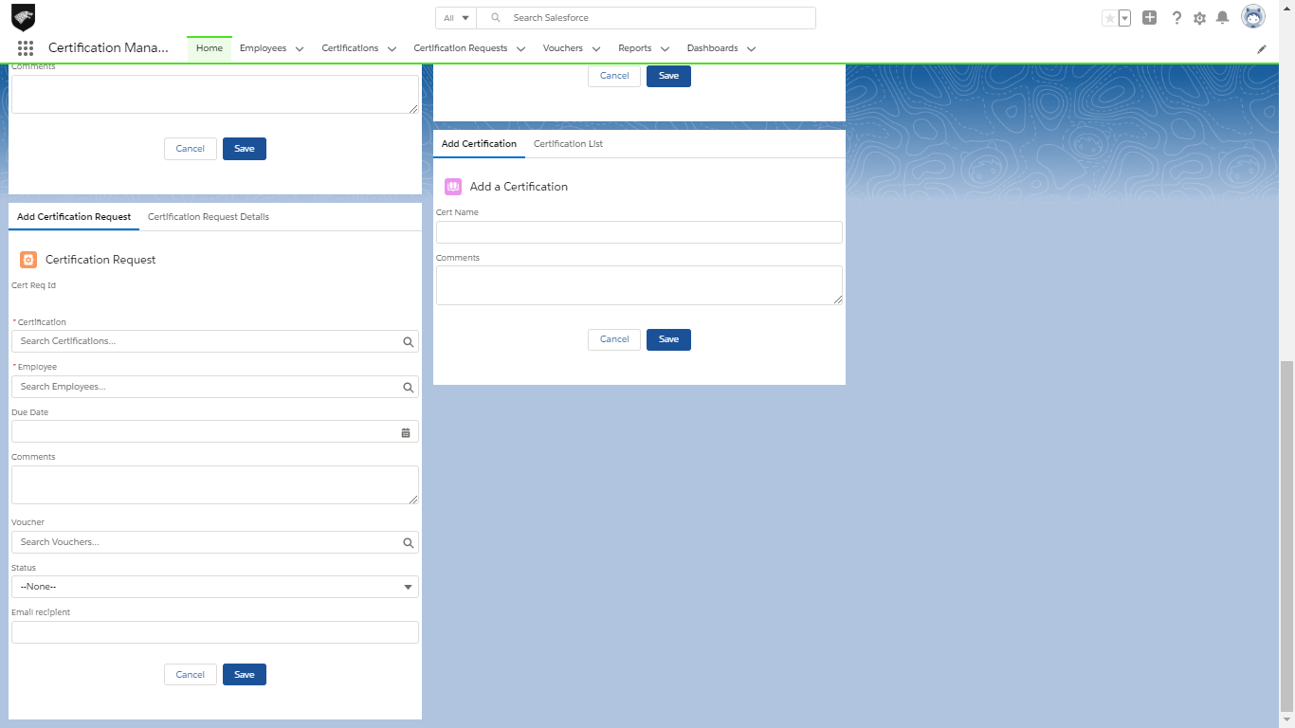
User Interface:

Slide 7
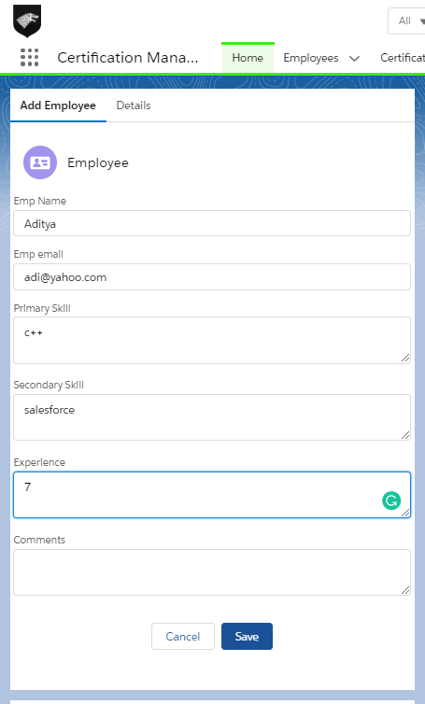

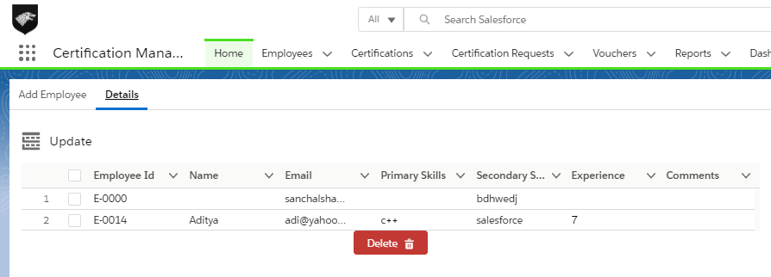
Employee
The Employee in CMA refers to the person(s) who are applying for a Certification.
The Employee Object stores the Employee(EMP) Name, Email, Skills, Experience, and Comments.
This section can only be managed by App User.

Slide 8
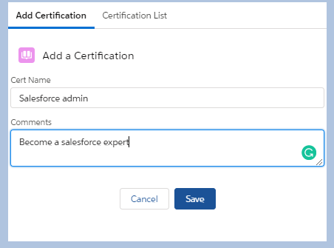

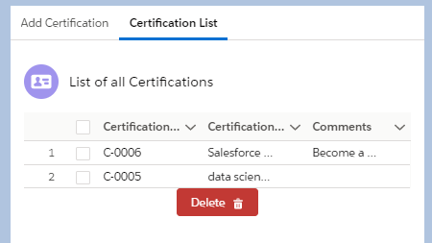
Certification
The Certification refers to the certificates that each employee or a set of employees can peruse.
The Certification Object in salesforce stores the Certification Name and the Comments of the certification if any.
This section can only be handled by the App Admin.

Slide 9
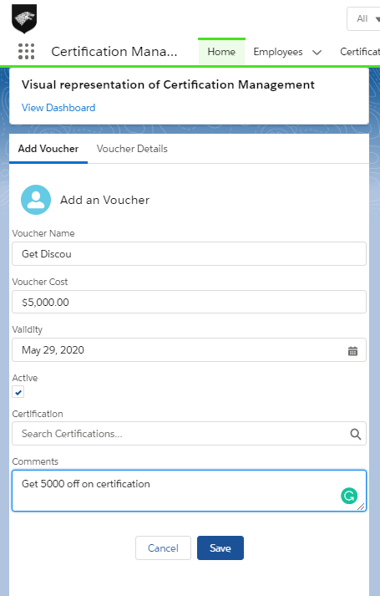
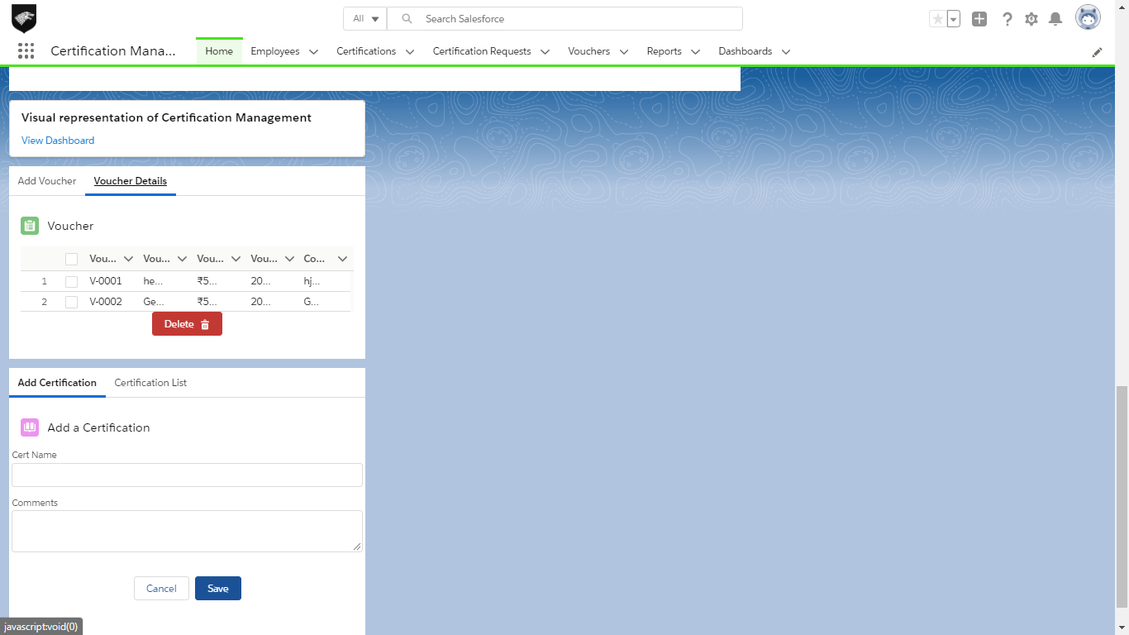

Voucher
The Voucher is a Voucher which can be applied to certifications, if available, to reduce the costs of the Certification exam.
The Voucher object in salesforce stores the Voucher name, Cost, Validity, Active, Certification it can be applied to.
The Voucher is not necessary for a request.

Slide 10
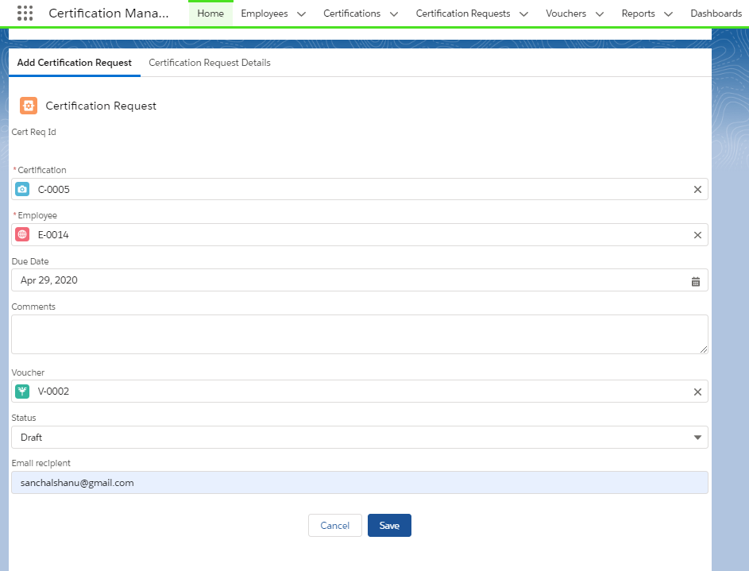

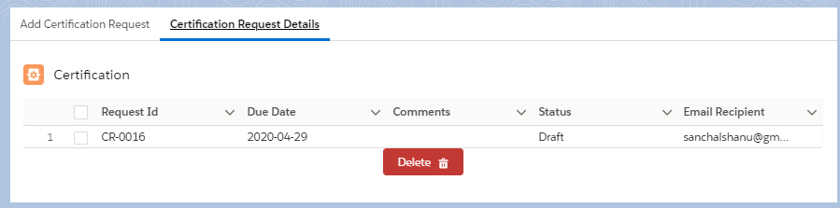
Certification Request
The Certification Request is used to apply for an certification request for a certain employee.
The Certification Request Object in salesforce stores the Certification name, Employee name, Due date, status Voucher name and the comments.
The certification request is managed by App User.

Slide 11
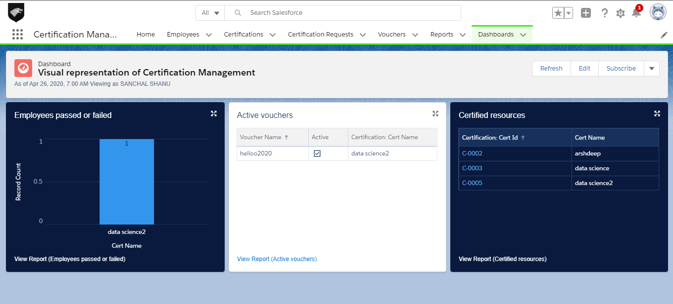
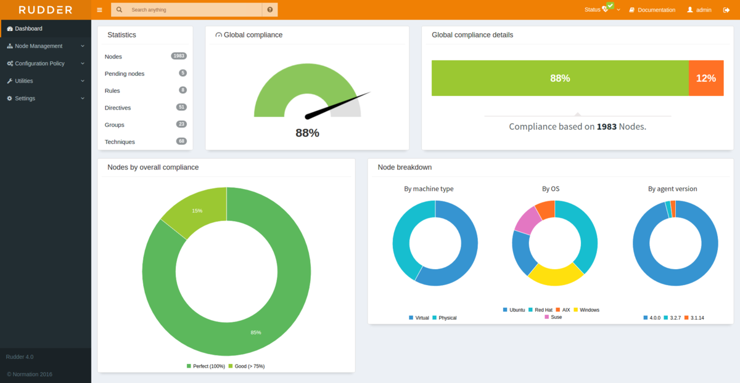
Reports & Dashboard
There are 3 types of reports in total over here
  Employee Pass or Fail
  Active Vouchers
  Certified Resources [No of certifications yet available]
All the reports are incorporated by the Dashboard as shown above.

Slide 12


Validation Rules Used:
App User can manage all Employee and Request related operations.
App Admin can manage all Certification and Voucher related operations.
App Admin is the approver for the Requests.
App User updates the Status later on to Passed or Fail.
Each Employee can have only one Certification.
Certifications can be reused, but not with the same Voucher.
If a Request is approved, but has no Voucher applied, and a Voucher is available, then it will be automatically assigned.

Slide 13

Assumptions:
However, we have made a few assumptions with respect to the application, which are:
Certification Request Status is changed to assigned only when it is approved not when voucher is assigned to the request.
App admin and app user are two different users. It is system administrator who is performing the task assigned to app admin in order to avoid many times login during approval process.
The Process does not accompany any kinds of proofs for their condition.
Employee shares the status of the certification request with app user to get the status changed over email.

Slide 14

Out-scope:
The following functionalities have not been covered under the application:
The application does not include any kind of login for the Employee.
The employee can only share his details and see his status on the page.
Third Party integrations are not yet included, except for Emails.
The Process does not accompany any kinds of proofs for their condition.

Slide 15




sanchalshanu.46022661@gmail.com
GitHub/sanchalshanu
sanchalshanu@gmail.com

